Slide 1
Chapter 14
Audit Requirements
https://www.nhaustin.com/training-and-certifications/course-outline/id/1000401014/c/adobe-indesign-cc-part-1
Notes:
Welcome to this presentation –Of Single Audit program requirements and new reporting procedures using TDA-GO.
In TDA-GO the Organization Compliance Single Audit Report form replaces the former Audit Certification Form, which Grant Recipient’s previously used to disclose federal grant expenditures for each fiscal year.
The acronym OSCAR will be use through out this presentation.
Please note that the new OCSAR reporting policy changes became effective for all the Grant Recipient’s FISCAL year ending in 2022.

Slide 2
Single Audit Act
Single Audit Act passed in 1984
Single Audit Amendments Act passed in 1996
Requires annual financial audits from recipients of federal assistance.
Replaced multiple audits for federal assistance programs into a Single Audit.
Regulations at 2 CFR Part 200 Subpart F
Applies to recipients of federal grants
Notes:
Single Audits are required by federal law under the Single Audit Act of 1984 and the Single Audit Amendments Act of 1996. The implementing rules for the single audit statutes are found in 2 CFR Part 200 Subpart F.
Note: The disclosure of expenditures made from state grants is not required.

Slide 3
Single Audit Program Policy
Chapter 14 of Implementation Manual
Organizational Compliance Single Audit form (New)
OCSAR Submission Procedures
Delinquent or Incomplete Filing
Notes:
New program requirements for Single Audit reporting can be found in Chapter 14 of the 2022- Implementation Manual.
We will go over
Single Audit reporting policy and procedures for filing OSCAR
The steps for submitting the OCSAR in TDA-GO.
And Delinquent or Incomplete single audit reporting.

Slide 4
Organization Single Audit Compliance (OCSAR)
OCSAR Required for all open Grant Agreements beginning with 2022 awards
Open – Period begins with FY during grant agreement start until TDA receives Project Completion Report.
Must be submitted within 9 months from Grant Recipient’s fiscal year end date.
May be submitted as early as the day after fiscal year end date.
This Photo by Unknown Author is licensed under CC BY
Notes:
The OCSAR is required to be submitted annually for all open grant agreements beginning with 2022 awards. “Open” means that at least one day in the fiscal year is after the grant agreement start date, and before the Project Completion Report is submitted.
The OSCAR must be submitted within nine months from the Grant Recipient’s fiscal year end date. This means the form may be submitted in TDA-GO as early as the first day following the end of the grant recipient's fiscal year end date.

Slide 5
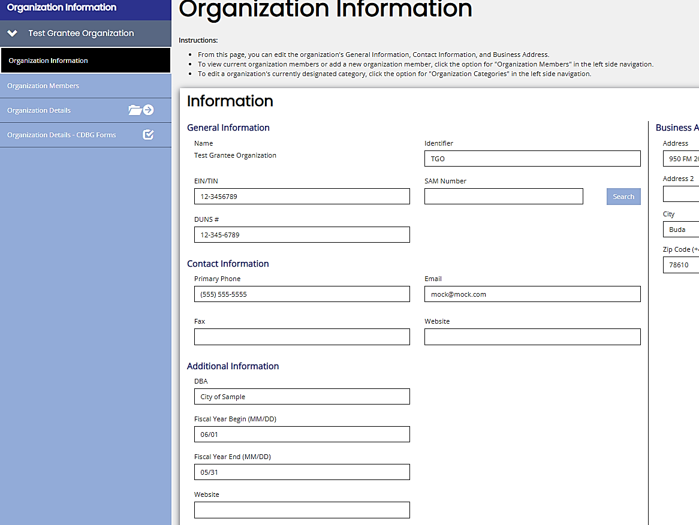
Organization Single Audit Compliance (OCSAR)
FYE Reported in TDA-GO
This Photo by Unknown Author is licensed under CC BY
Notes:
Organization page in TDA-GO will show fiscal year end reported to TDA , see the RED box.

Slide 6
Organization Single Audit Compliance (OCSAR)
Change to FYE in TDA-GO
This Photo by Unknown Author is licensed under CC BY
Notes:
If the fiscal year end date is wrong or the community needs to change it, the community must submit documentation signed or emailed by the Authorized official stating the new fiscal year end date.
The documentation must be upload in the organization details page, under upload description – See RED box.

Slide 7
Continuation -OCSAR - ROLES
OCSAR Required for all open Grant Agreements beginning with 2022 awards
The OCSAR must be completed by the Grant Recipient’s certifying officer, designee, or CPA firm.
This Photo by Unknown Author is licensed under CC BY
Notes:
While this new reporting procedure replaces the Simplified Audit Certification Form, many of the submission requirements remain the same. For instance, TDA still requires that single audit threshold report be prepared by same
local official or staff member that is authorized to certify a payment request.
** If a CPA is assisting an organization with reporting, they can be invited to the organizations page in TDA-GO as a consultant..
It is important to remember that a Grant Admin may (NOT) serve in this role.
As a best practice,
Appoint at least two people who are authorized to complete and certify the OCSAR in TDA-GO.

Slide 8
Single Audit Compliance
This Photo by Unknown Author is licensed under CC BY
Single Audit threshold $750, 000.00
Notes:
The Single Audit compliance page now provide the required information to determine if a single audit must be submitted to the Federal Audit Clearinghouse (FACH).
Per the 2022 implementation manual, the single audit threshold is $750,000.00 for fiscal year end on or after December 25, 2015.
If additional information is needed based on a response , additional questions will appear.
As a Best practice: –Have the information regarding the Single Audit on hand in order to help answer the questions that will follow with this process.

Slide 9
Federal Grant Expenditures
This Photo by Unknown Author is licensed under CC BY
Notes:
Based on the responses to the questions for #1 and #2 , this chart may be required.
The Grant Recipient must enter data for all expenditures from federal grant which occurred during the fiscal year. The data includes ,
- The Federal Grantor;
The Pass-Through Grantor (if any)
The Program Name
The Catalog of Federal Domestic Assistance number
- The Grant Number and
- - The Amount of expenditures made during the fiscal year.
As a Best Practice- If the organization requires clarification of the chart prior to submitting the OCSAR report, Contact your CPA.

Slide 10
Single Audit Record
This Photo by Unknown Author is licensed under CC BY
Notes:
If a Single Audit Record is required, the form cannot be completed until the audit information has been reported to the Federal Audit clearinghouse .
For the Assessment of Risk on the Single Audit Record page the Grant Recipient will need to provide responses.
TDA utilizes information from the single audit record to assess risks and financial management deficiencies which may be identified in an audit.
Before submitting the OCSAR report in TDA-GO, the Grant Recipient must upload a copy of the email received from the Federal Audit Clearinghouse confirming acceptance of the Single Audit Report and any findings.
See the RED box on screen – for the upload field.
NOTE: Even if a Grant Recipient is exempt from single audit submission requirements for a particular fiscal year, records must be ready and accessible for review by any official of the federal agency, TDA, or the General Accounting Office.
As a Best Practice: The Grant Recipient should retain a copy of the acceptance letter from Federal Audit Clearinghouse to have proof of the receipt date and acceptance of the Single Audit record . This pertains only to grants recipients that met the threshold requirements for future auditing purposes.

Slide 11
Single Audit Record
This Photo by Unknown Author is licensed under CC BY
Notes:
Here is an example of the FACH acceptance email .

Slide 12
Submission of OCSAR
This Photo by Unknown Author is licensed under CC BY
Notes:
The OCSAR- must be submitted in TDA-GO within nine months of the fiscal year end date.
Failure to submit the OCSAR, within nine months constitutes non-compliance with grant requirements.
ALL grant funds pending or awarded to the Grant Recipient will be suspended until an acceptable OCSAR is submitted.
TDA recommends the grant recipient set a calendar reminder for both the community’s fiscal year end and OCSAR submission.
As a Best Practice - TDA strongly encourages Grant Recipients that have not exceeded the threshold to submit the OCSAR as soon as possible after the fiscal year ends.
Chapter 14 is available to assist with processes and further details on Laws and Regulations.

Slide 13
Delinquent or Incomplete Filing
Non receipt or incomplete of SA reports may result in:
A hold on contract amendment requests
Suspended funding on all open contracts
Ineligibility to apply for TxCDBG assistance
Place a hold on any newly awarded contracts
Notes:
These are NO ‘ NO’s that nobody wants!!
Holds on contract amendments
Suspended funding on open grants
Ineligibility to apply for CDBG grants.

Slide 14
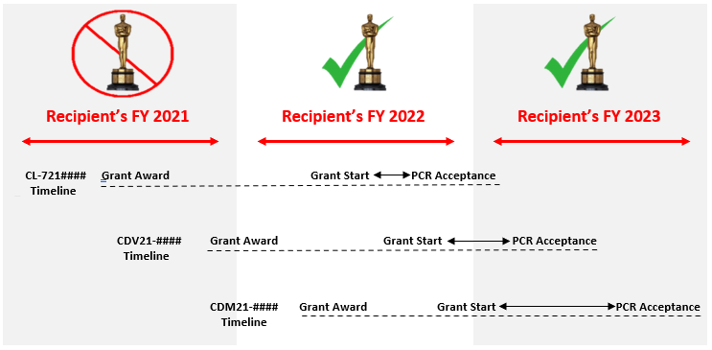
Timeline for Reporting
Notes:
This image is an example for one organization and Oscar requirements for a fiscal year.
This organization has 3 CDBG grants.
Expenditures to be reported will begin on the Grant start date and will continue until the PCR acceptance date.
In the example, FY 2021 has no expenditures because none of the 3 grants have started.
For FY 2022,
Grant CL-721 has started and the PCR accepted, so all expenditures must be reported.
Grant CDV21 has started and may have expenditures to report.
For FY 2023,
Grant CDV21 is in process and the PCR accepted, so all expenditures during this time should be reported.
Grant CDM21 has started, and the PCR accepted, so all expenditures during this time should be reported.

Slide 15
Helpful Links
The SA Report must be submitted to the Federal Audit Clearing House (FAC).
Go to https://harvester.census.gov/facweb/, for instructions on filing the SA report.
The Texas State Board of Public Accountancy -https://www.tsbpa.texas.gov/
For further assistance:
Rosalinda.Hamilton@TexasAgriculture.gov
This Photo by Unknown Author is licensed under CC BY
Notes:
These are helpful links to assist grant recipient‘s with audit submission.

